Slide 1
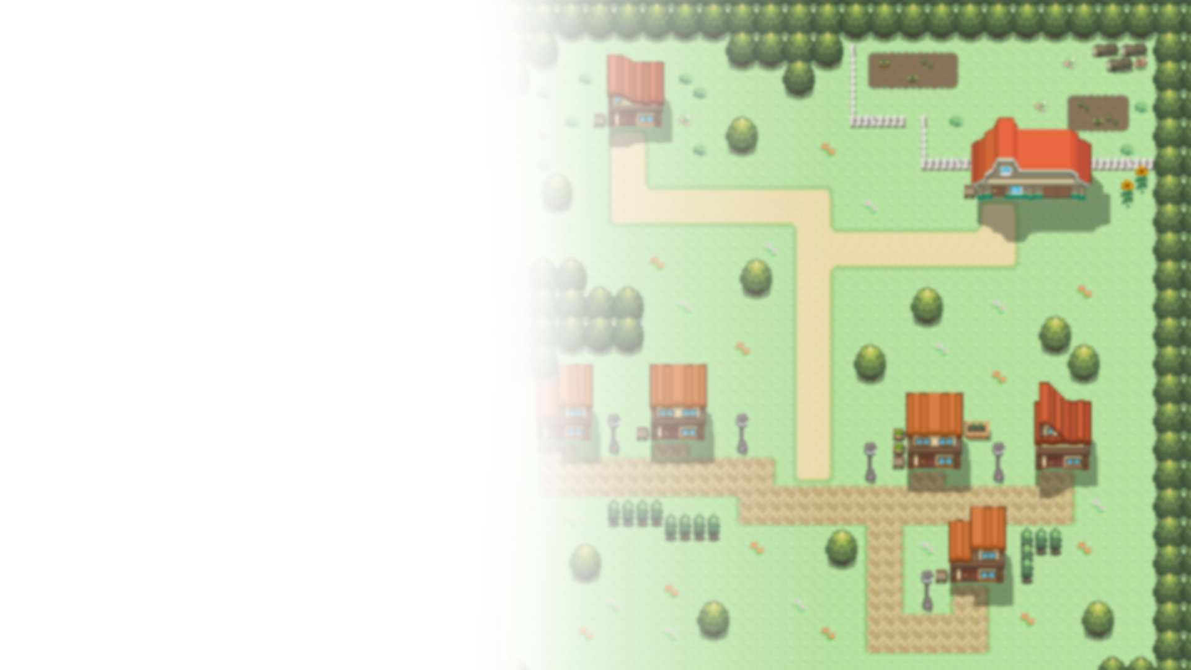
FETCH QUEST
Anthony (Tony) Gentile
IT3049C Final Project

Slide 2
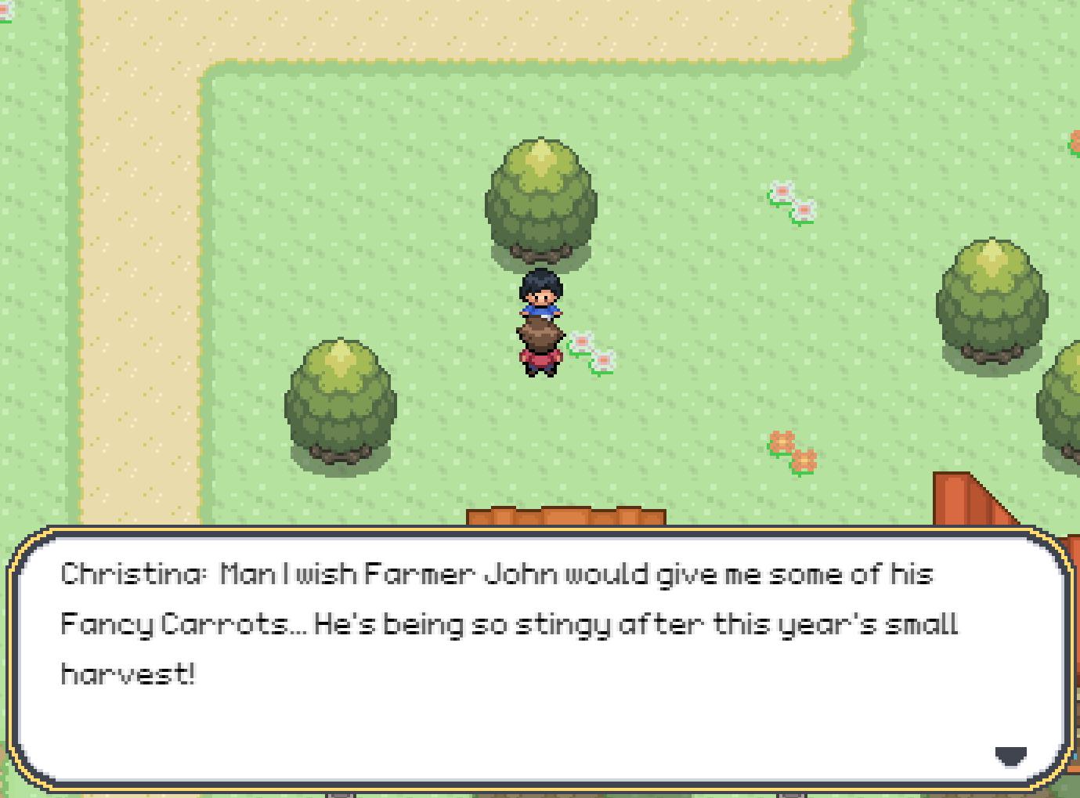
What is Fetch Quest?
Short Story RPG
Based on “fetch quest” trope
Top-Down tile based movement
Pokémon-esque Artstyle
“It’s extremely user friendly and enjoyable”
- TJ Brown

Slide 3




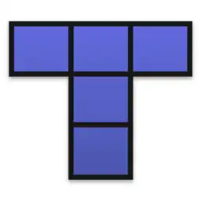
Technologies Used
HTML + JavaScript
Phaser
TILED
Aseprite

Slide 4
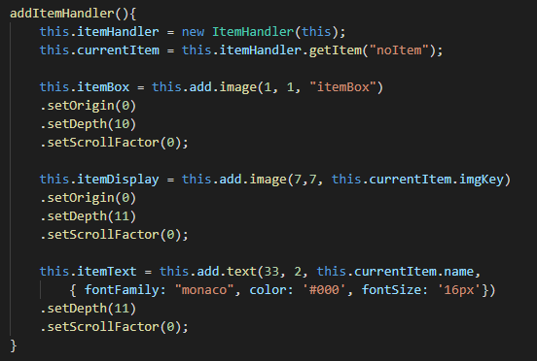
Development Process
Tile-based movement mechanics
Interactive NPCs
Animations and Mapping
Dialogue Boxes
Inventory
Game Logic
Artwork and Music
“I don’t know what I expected”
- Colin Motuzas

Slide 5
Goals
Takeaways
Create a scalable engine
Focus on polished mechanics
Make an appealing design
Become more experienced with JavaScript
Game development is difficult
Clean, legible code is important
Version control is extremely helpful

Slide 6
Credits
ChaoticCherryCake & many more - Tileset Art
(https://www.deviantart.com/chaoticcherrycake/journal/Credits-for-Tiles-367931482)
Rawin - Custom Music
(https://rawinng.newgrounds.com)
Jamie Place - 'Monaco' Font
(http://fontstruct.com/fontstructions/show/753435)
Johannes Baum - Grid based movement tutorial (loosely followed)
(https://medium.com/swlh/grid-based-movement-in-a-top-down-2d-rpg-with-phaser-3-e3a3486eb2fd)
“Engaging dialogue, great sprites, fantastic carrots”
- Howard Wood

